Slide 1
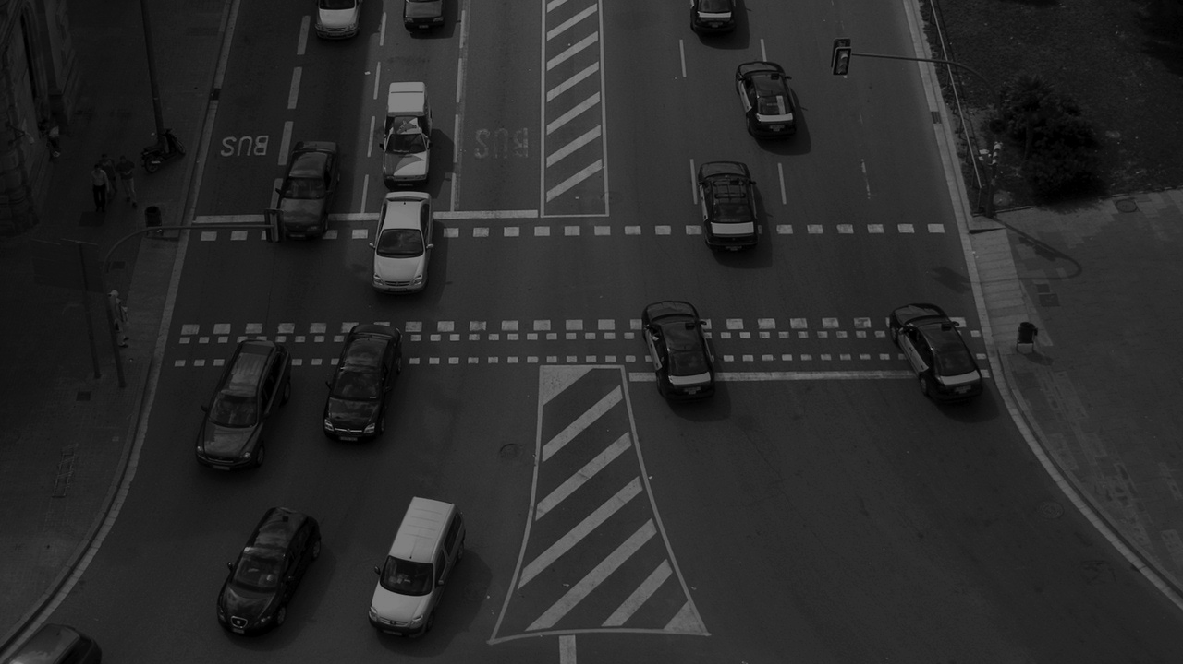
Traffic light switching and
Traffic density Calculation using Image and Video Processing
PBS Dept. of Information Technology, MIT College of Engineering, Pune Version 1.0
Sujay Sanjay Mahadik | TE-IT-B | 3154067

Slide 2
What is Image and Video Processing?
Image processing is simply a form of signal processing for which the input is an image, such as photographs or frames of video.
Analysis and manipulation.
Output can be an altered image or a report.

Slide 3
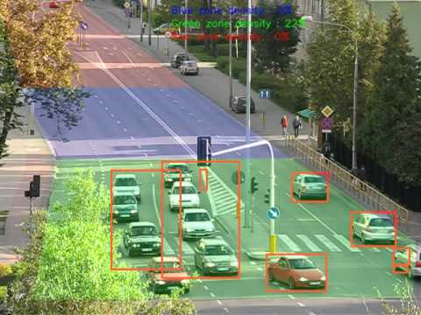
Application of Image and Video Processing
In Traffic density calculation

Slide 4
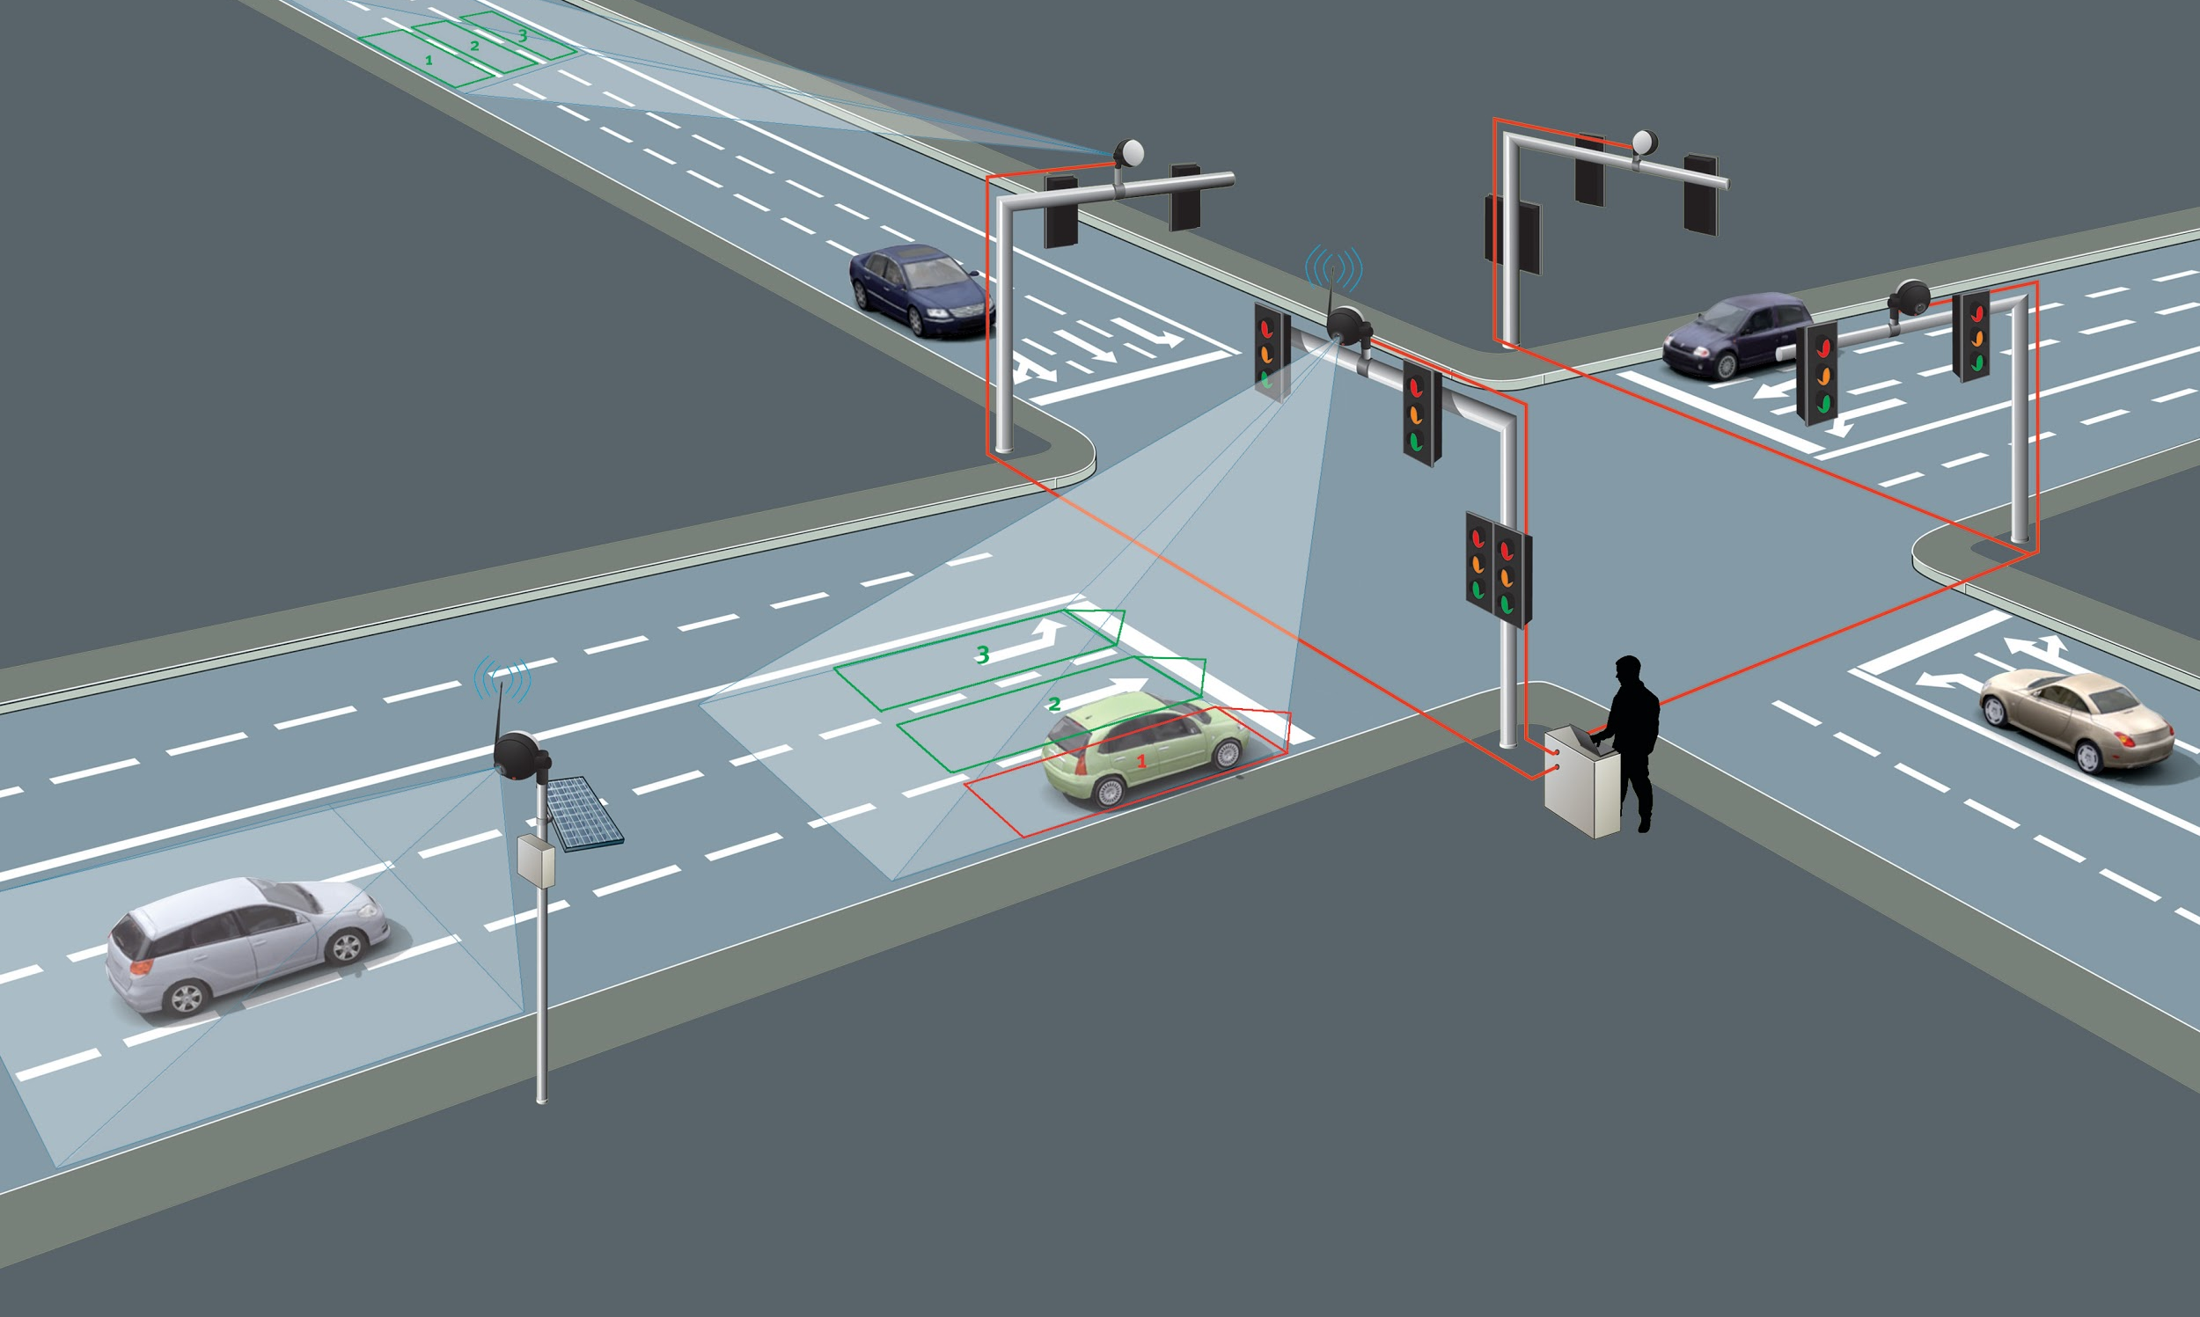
What is different in Dynamic Traffic light
Switching?

Slide 5
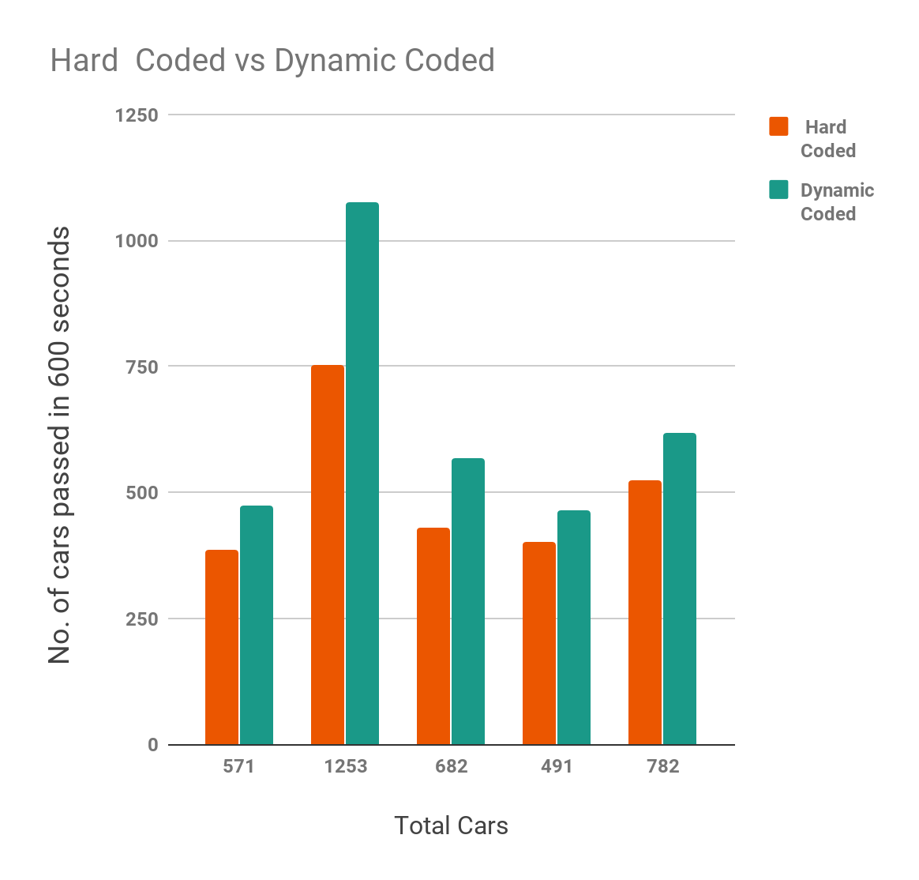
Experiment data
Here we have taken into account random number for each side such as 0, 1 or 2 cars can arrive per second randomly and both the algorithms (Hard coded and Dynamic coded) are run on the same set of numbers for 600 secs.
Results from:
[1] Smart Traffic Lights Switching and Traffic Density Calculation using Video Processing
http://ieeexplore.ieee.org/document/6799542/

Slide 6
Testing Instances and Results

Slide 7
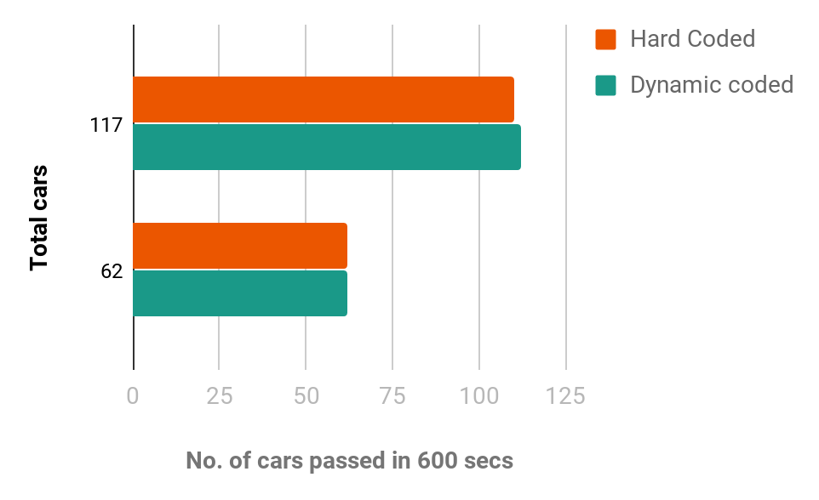
Idle Time
Considering very low traffic density. 0 or 1 vehicle adds up in every 10 seconds.
We don't see much difference in the number of cars passed.
But the difference lies in the aspect of waiting time
Worst case scenario:
Hard coded - 180 secs. (considering each signal requires 60 secs to turn back to green)
Proposed Hard coded - 30 secs. (considering each signal requires hard coded 10 secs for Idle Times)
Early Morning | 6 am to 8 am
Mid-night | 12 am to 2 am

Slide 8
Peak Time
Density is very high on the roads majorly because of office and school hours.
Dynamic coded algorithm on average has shown an improvement of about 35% above the Hard Coded system.
Morning | 8 am to 10 am
Afternoon | 4 pm to 6 pm

Slide 9
Normal Time
During this time the number of vehicles can range anywhere between very high to very low.
Hard coded systems are undesirable in such cases.
Dynamic coded systems which alter the switching of traffic lights according to the traffic are best suited.
Late morning | 10 am to 4 pm
Late night | 8pm to 10 pm

Slide 10
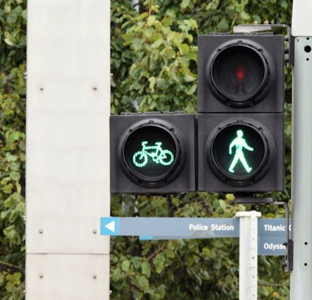
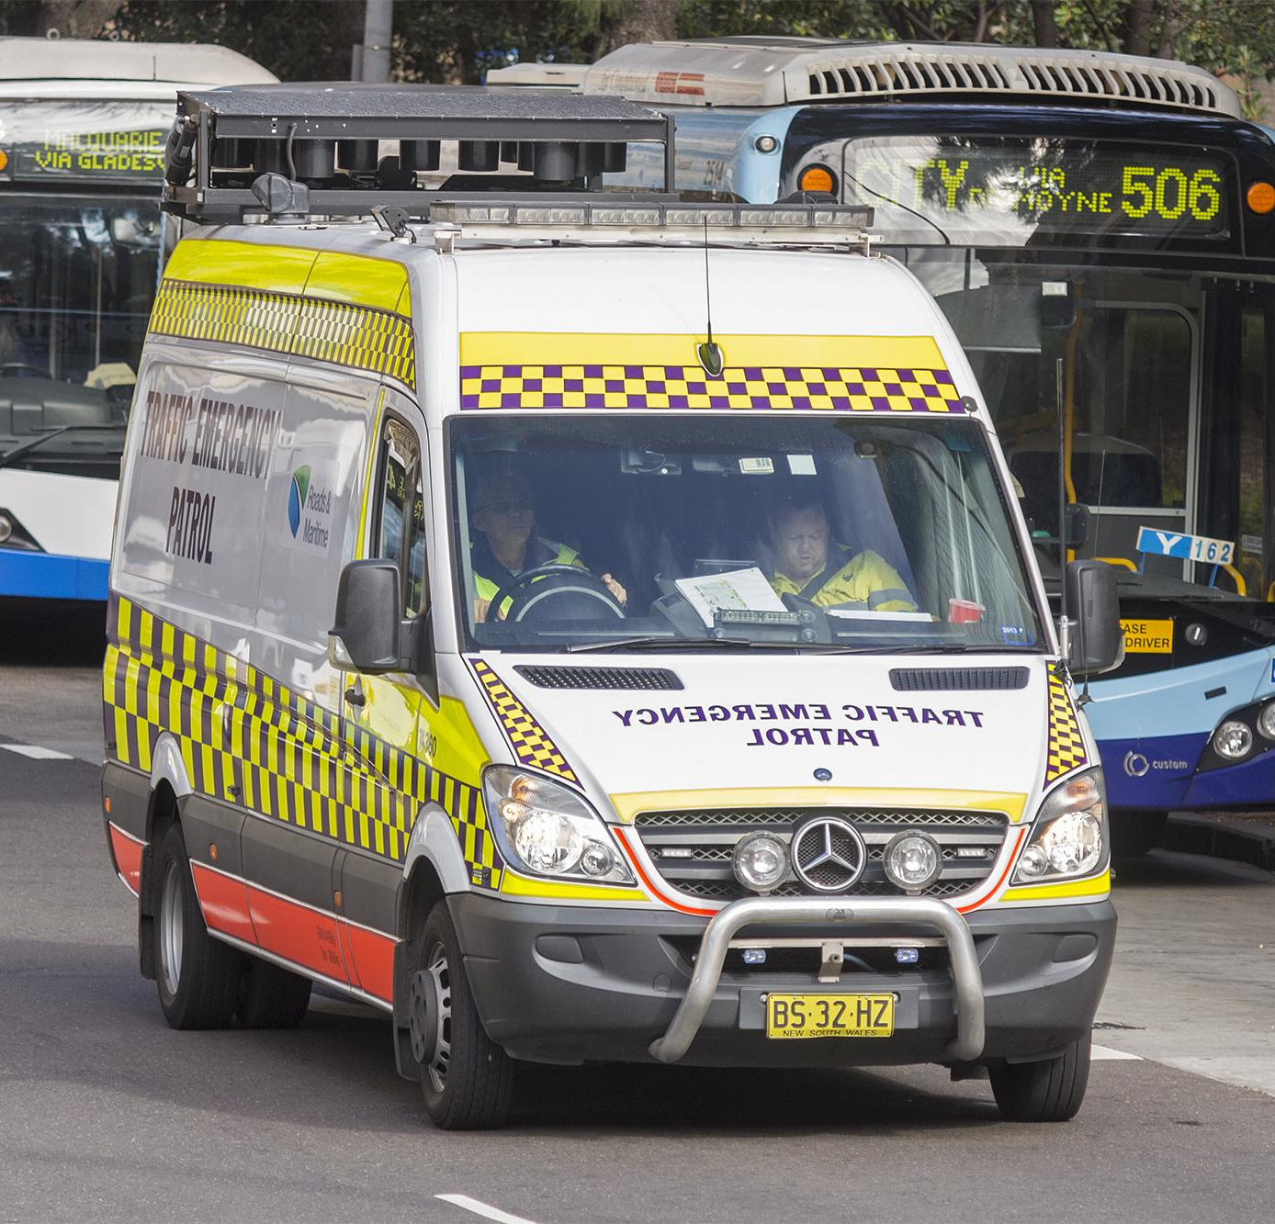
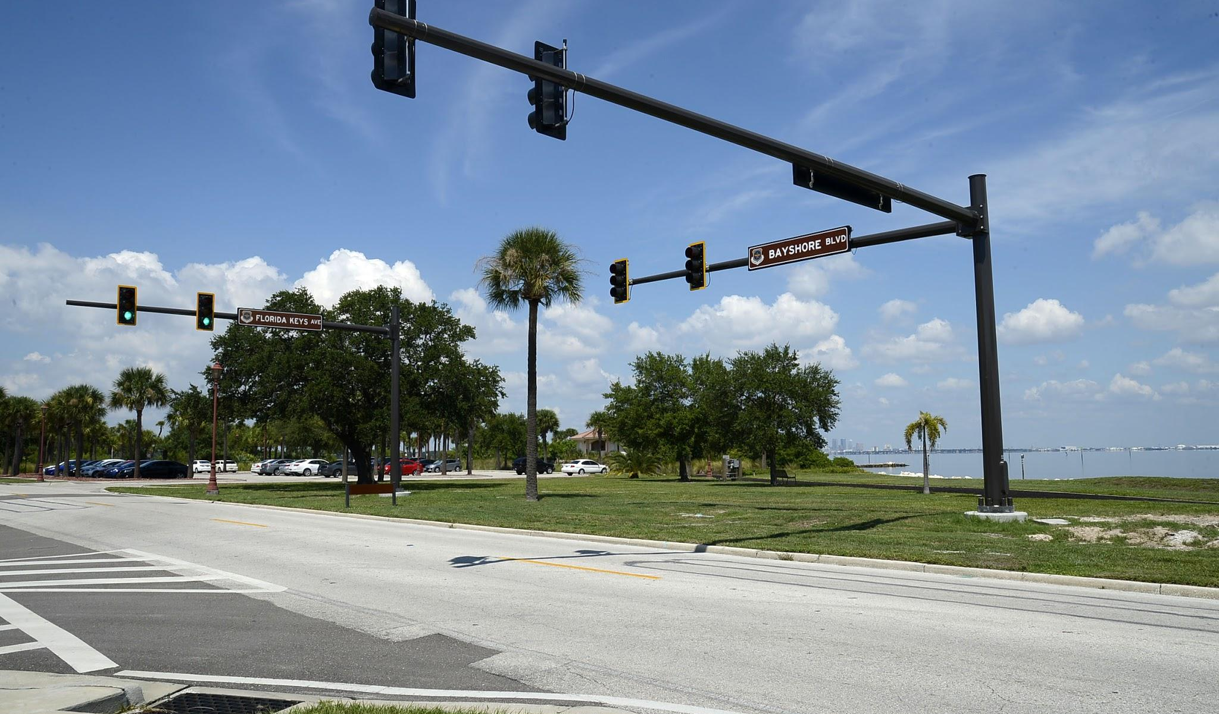
Conclusion and Future prospects.
Low installation cost and Negligible maintenance cost.
Vehicle Recognition for EVs such as ambulances and Fire Engines.
Spacious movement of vehicles.
Scope of this project can be extended to Coordination Control.
Data acquisition for future road design and construction.
Improvements for junctions with higher waiting times.

